Slide 1
Microfinance Karnataka Summit 2023
N Srinivasan
Bengaluru 12 Sept 2023

Slide 2
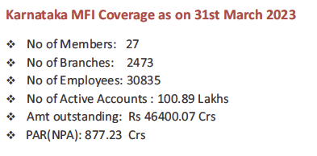
Karnataka MF - Some features
Cradle of banking and finance institutions
Spawned many MFIs
Positive and enabling environment
Enterprise culture and credit discipline
Active and informed government support
Responsible finance behaviour of MFIs
MF and SHG streams work in tandem, without hostility
Changes in government do not impact public policy or approach
Harmony in the field, despite competition
Yes, AKMI has played a significant role

Slide 4
Sharp increase in MF loans outstanding in FY 2023

Slide 6
Comparison across states
As Bihar and UP grow faster, Karnataka in fifth place
Best risk profile across the top five states

Slide 7
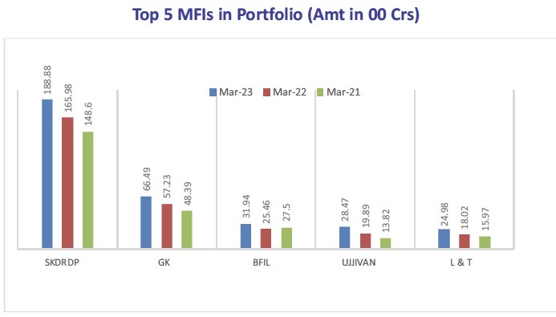
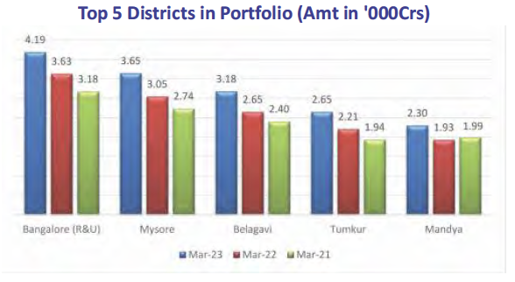
Geographic and institutional presence

Slide 8
Comparison across districts – low income districts have relatively larger loan size
Top five Districts | Average loan per capita | Loan as % of income | Bottom five Districts | Average loan per capita | Loan as % of income
Bengaluru Urban | 68067 | 13 | Kalaburgi | 30783 | 31
Udupi | 67435 | 23 | Vijayapura | 33051 | 29
Dakshin Kannada | 59852 | 16 | Yadagiri | 33300 | 29
Uttara Kannada | 48323 | 29 | Ballary | 33380 | 19
Chickmagalur | 46799 | 16 | Bidar | 33590 | 30
Karnataka State | 42194 | 19 | Karnataka State | 42194 | 19

Slide 9
Portfolio quality
Name of district | % of PAR accounts | Name of district | % of PAR outstanding
Mysuru | 16.5 | Mysuru | 5.4
Chamarajanagara | 15.7 | Vijaypura | 4.7
Bengaluru U | 15.1 | Chamarajanagara | 4.6
Mandya | 14.7 | Bengaluru U | 4.3
Udupi | 13.4 | Ramanagara | 4.3
Mysuru, Bengaluru U and Chamarajanagara need attention

Slide 10
Clients voice
Survey carried out by Shaisavi Project Consultants Ltd
2300+ customers in 7 districts covered
Findings :
89% customers preferred MFIs over other lenders
Quick loan sanction, facile processes and easy access – key differentiators
90% of loans were applied for income generating purposes
More than 60% customers reported positive impact on livelihoods/business
More than 65% customers reported positive impact on family well being
Women gain autonomy in running income generation activities
Women gain better space in family decision making

Slide 11
Credit + activities
MFIs very active beyond credit
Focus on literacy, health, livelihoods,Women and children, skill development, Enterprise dev, disaster relief, (COVID relief), school and hospital infrastructure, Persons with disabilities, drinking water and Sanitation, environment protection
Both CSR and mainstream support
Extensive and intensive work on financial literacy and livelihood skills, enterprise building

Slide 12
Typical concerns
High interest rates charged – livelihood activities don’t produce high returns
Product structures unsuitable – Not all livelihoods have monthly income flows
Sustained customer development is not focused as customer attrition rate is high
Group meetings – heavy demand on customers’ time
Digitalisation of cash txns – can weaken relationships
Competition erodes “good practices”
Innovations are limited to technology adoption

Slide 13
Some reflections
MFIs have done a power of good to vulnerable, low income people
Customers come back in multiple cycles on account of the utility and functionality of MF credit (despite all criticism)
Several customers improved their livelihoods and quality of life, through sustained access to MF
Customers become financially competent as well as disciplined, both through training and practice

Slide 14
Moving ahead
As we move forward we need to
Innovate
Diversify products
Reduce interest rates to the extent feasible
We need support of government and regulator for
Lower cost of funds – if farm and SHG loans can be subsidized, why not MFI loans
If banks can give SHG loans at 9 to 10%, why not provide MFIs loans atleast at the same rates
Allow MFIs to diversify loans to micro enterprises by lowering threshold of qualifying assets to 50%
Allow MFIs also to issue PSLCs and participate as sellers of PSLCs

Slide 15
Thank you

